Slide 1

Project analysis slide 2
Grid Synchronization
of
3-ф , 2 Level Voltage Source Invertor
Using Synchronous Frame Reference Technique
Guide : Dr. M.K. Khedkar
Aditya Deshmukh Abhishek Bhavsar Kalpit Jangid Ankit Kanojia

Slide 2

Project analysis slide 2
Index
Introduction
Grid Connection Principle
Topologies of Grid Connection
3-ф Grid Connection
DQ Axis Theory
DQ Transformations
Grid Synchronization
Phase Locked Loops
SRF-PLL
Block Diagram
Circuit Model
Hardware Details
References
Contents

Slide 3
Project analysis slide 2
Introduction
In general practice, a grid system consists of a multitude of generating sources, transmission systems and loads. It is generally a very complicated network and requires a great deal of real time monitoring of circuit parameters to keep the entire system stable. If a fault condition pops up in a certain part of the system, it has to be ensured that the affected part is isolated from the grid without hampering the power supply to the rest of the grid. Although, this is an interesting area to look into, our project mainly deals with how to get an isolated system back in tune with the grid so that maximum transfer of power can take place.
Another case where the synchronization study is required is the effect of dynamic loading on the grid network. In a practical system, loads can be variable. For example, in case of industrial load, it requires maximum power transmission during the daylight period and nightfall generally beckons the start of minimal power requirement period. This dynamic loading can cause the supply current to get out of phase with the supply voltage which leads to avoidable losses. So, it is necessary that there is a system in place to counter and solve this problem so as to minimize losses and increase efficiency.
The purpose of synchronization is to monitor, access, enable, and automatically take the control action to prevent the abnormalities of voltage and frequency by the minimization of difference in voltage, frequency, and phase angle between the corresponding phases of the generator output and grid supply. India has unstable grid. It keeps varying in different regions and states of India. The voltage varies from 110 to 270V, because of that grid feed is affected by unstable voltage which directly affects the inverters.
Hence, as an example, in our project, we will study how a 3-phase, 2 level VSI can be synchronized with the grid using the synchronous reference frame technique.

Slide 4
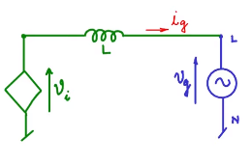
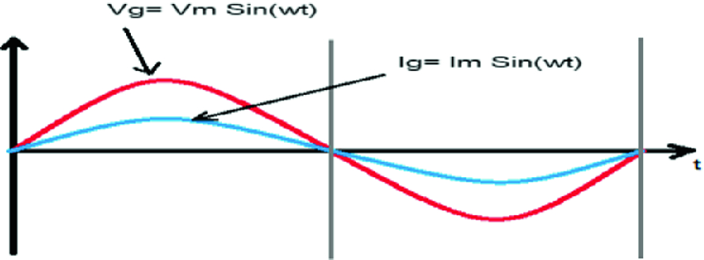
Project analysis slide 2
Grid Connection Principle
An electrical grid , is an interconnected network for delivering electricity from producers to consumers. It consists of generating stations that produce electric power; Electrical substations for stepping up voltage for transmission or stepping down for distribution.
Definition of Grid :
Generalized Circuit Diagram of connection of a VSI to the grid :
Where, v_{i} : Inverter Output Voltage.
v_{g} : Grid Voltage.
i_{g} : Current flowing into the grid.
L : Inductance between the grid and the VSI.
v_{L}
Since maximum power has to be supplied to the grid, it is imperative that i_{g} to be in phase with v_{g} :

Slide 5
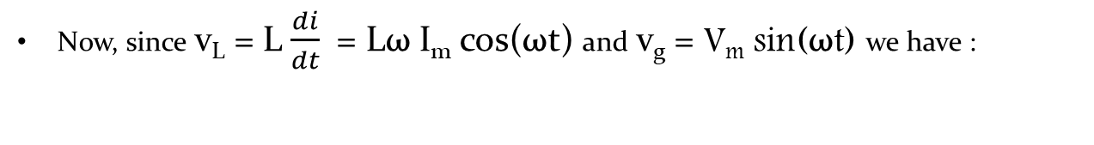

Project analysis slide 2
Grid Connection Principle
Applying the KVL across the circuit, we have : v_{L} + v_{g} = v_{i}
Now, since v_{L} = L $\frac{di}{dt}$ = Lω I_{m} cos(ωt) and v_{g} = V_{m} sin(ωt) we have :
v_{i} = V_{m} sin(ωt) + ωL i_{m} cos(ωt)
Simplifying we have : i_{g} = $\frac{1}{L} \int{\left(vi −vg\right) dt}$
For maximum transfer of power, v_{i} which is a controlled source is regulated such that it satisfies the above stated equation.
This can be achieved by using the i_{g} current value as a reference for the control input to the VSI so that the v_{g} is regulated such that optimum current i_{g} flows through the circuit.

Slide 6
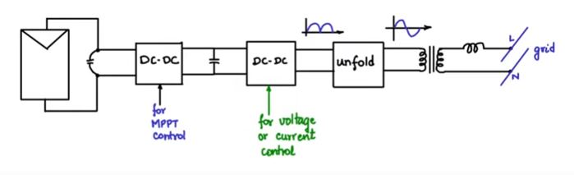
Project analysis slide 2
Topologies of Grid Connection
To understand the various types of topologies that can be used for grid connection, we use a case-study of grid connection of a PV module to the grid.
The job of the first DC-DC convertor is to control the input impedance for maximum power point tracking while the job of the second DC-DC convertor is to control the output voltage on the downstream side.
The output after the two DC-DC convertors is varying unidirectional in nature and the variation is in the shape of a rectified sine wave. The duty cycle of the latter DC-DC convertor can be controlled so that a rectified sine wave is obtained.
The output of the second DC-DC convertor goes through an unfolding circuit which converts the rectified sinusoidal wave to a proper sinusoidal wave at the output.
This sine wave is passed through a low frequency isolation transformer (50 Hz) and its output is passed through an inductor which is further connected to line and neutral of the grid.

Slide 7
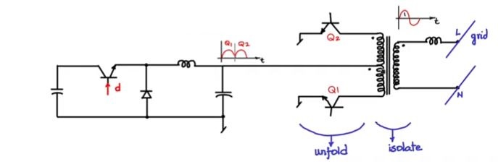
Project analysis slide 2
Topologies of Grid Connection
Taking a closer look at the second DC-DC convertor and the unfolding circuit, we have :
The duty cycle of the DC-DC convertor is modulated such that a rectified sine wave is generated as the output.
When Q1 is switched on i.e. in the first half-cycle, all dots ends of the push-pull transformer are connected to positive side, so the output generated will also be positive. When Q2 is switched on, all non-dot ends are connected to the positive side, hence that portion of the wave gets inverted.
So, Q1 and Q2 are switched alternatively at low frequency ( 50 Hz i.e. 20 milliseconds) so as to get a continuous sine wave which is interfaced with the grid through the inductor.

Slide 8
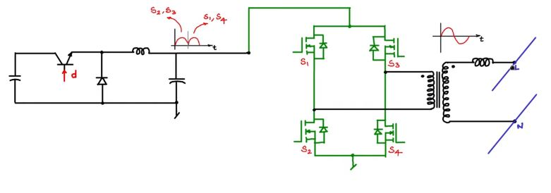
Project analysis slide 2
Topologies of Grid Connection
However instead of a coupled unfolding-isolation stage having BJTs as the power switch, generally MOSFETs with an internal body diode are the preferred choice. A full bridge stage is used as follows :
In the first 10 milliseconds, suppose S2 and S3 are switched on. In this time period, the dot end of the transformer is connected to the positive end of the DC-DC convertor and the negative is connected to the DC-DC convertor, so the output for this 10 milliseconds interval will be the same as the input
In the next 10 milliseconds, S1 and S4 are switched on, switching off S2 and S3. In this interval the dot end of the transformer is connected to the negative end of the DC-DC convertor. Hence the output of this interval will be inverted.
This is one of the examples of the multiple topologies used in grid connection.

Slide 9
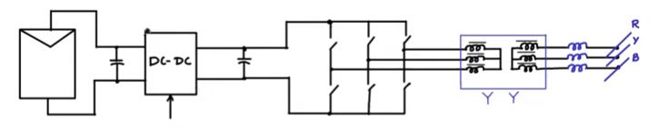
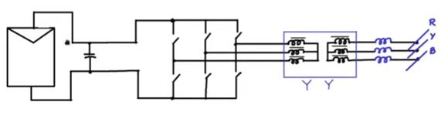
Project analysis slide 2
Topologies of Grid Connection
Topology for a 3-ф grid connection of a PV module is as follows :
The switches are shown symbolically. They can be any controlled power switches i.e. MOSFETs or IGBTs.
If the invertor in use is current controlled, the DC-DC convertor can be eliminated and the task of maximum power point tracking can be integrated in the invertor.
If the invertor is current controlled, then the maximum power point tracking algorithm can be used at the terminals of the PV panel.
The terminal voltage and terminal current of the PV panel can be tracked and the power obtained can be passed through the MPPT algorithm. The output is then set as the reference for the invertor.
This is an example of a topology where there is a single power stage between the PV module and the grid connection.

Slide 10
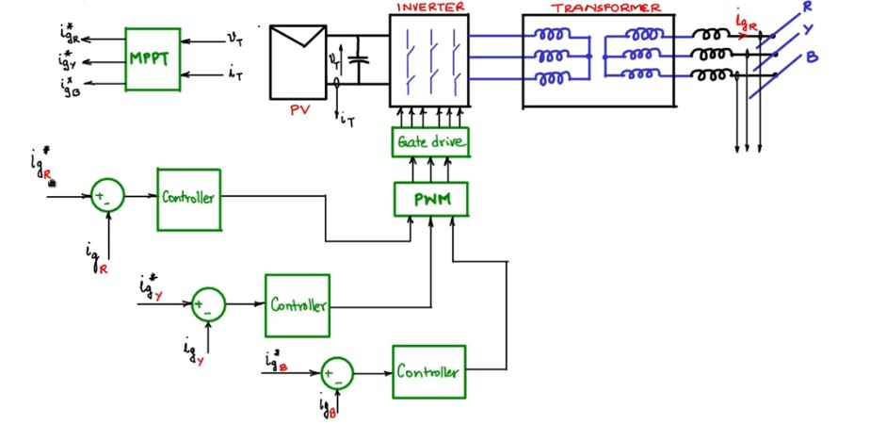
Project analysis slide 2
3-ф Grid Connection
As a case study, let us take the example of grid connection of a PV module :
Block diagram of 3-ф Grid Connection of a PV module

Slide 11
Project analysis slide 2
3-ф Grid Connection
The 3-ф invertor output is connected to the primary of the transformer and the secondary is connected to RYB phases of the grid through inductors. The 3-ф invertor has 6 gate drives i.e. IGBTs and MOSFETs and they have to be driven by a gate drive circuit. The gate drive gets its control signal from a PWM block. The input to the PWM block will be the control signals coming from the PI/PID controllers.
If suppose, we want to control the inductor currents, we sense the inductor current at each phase using a Hall sensor or using resistive shunts and differential amplifiers. We take a comparator block and input in the sensed current of each phase and the reference current for each phase. Thus, the outputs from 3 comparator blocks i.e. for each phase is then supplied to the PWM block.
As for setting of reference current, we set up a MPPT block which will take the terminal voltage and current from the PV module and output the optimum peak reference currents which are then supplied to the comparator blocks. It is to be noted that the output of the MPPT module is a sinusoidal wave and not a DC signal.
One of the drawbacks of this system is that since both inputs of the comparator are sinusoidal, it will become a tracking controller instead of a setpoint controller. The bandwidth in case of a tracking controller is significantly lower than that of a setpoint controller. Therefore design will become more complex.
Another drawback will be that due to presence of 3 comparator blocks and dynamic coupling of all three phases, the real time tuning of all three comparator blocks will become quite hard.

Slide 12
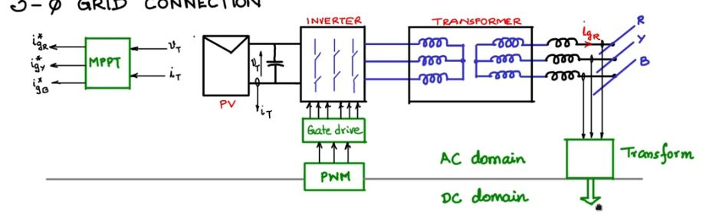
Project analysis slide 2
3-ф Grid Connection
In a 3-ф grid connection system, it would be ideal if the controller blocks are replaced with variables in the controller region as DC. All the signals in AC domain will be converted to DC signals by passing it through a frame transformation block.
Therefore to the controller, the variables will appear as DC and hence a setpoint controller can be made. This would give a much better response and the controller will be much simpler and will have a better bandwidth and performance.
To do the following, study of DQ-axis theory is required.

Slide 13
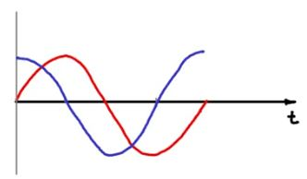
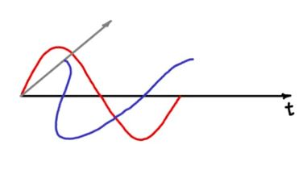
Project analysis slide 2
DQ Axis Theory
The DQ transform is often used in the context of electrical engineering with three-phase circuits. The transform can be used to rotate the reference frames of AC waveforms such that they become DC signals. Simplified calculations can then be carried out on these DC quantities before performing the inverse transform to recover the actual three-phase AC results.
As an example, the DQZ transform is often used in order to simplify the analysis of three-phase synchronous machines or to simplify calculations for the control of three-phase inverters. In analysis of three-phase synchronous machines the transformation transfers three-phase stator and rotor quantities into a single rotating reference frame to eliminate the effect of time-varying inductances.
Consider two time signals where one is a sine wave and other is a cosine wave. When plotted against the time axis, it will be seen as :
It is assumed that the sine wave is placed in a vertical plane. Now, we consider an orthogonal axis and place the cosine wave on a horizontal plane. When both are plotted against the time axis, it will look as follows :

Slide 14
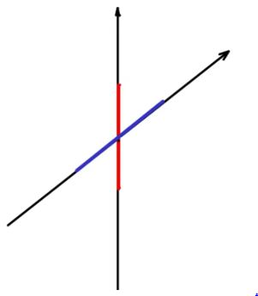
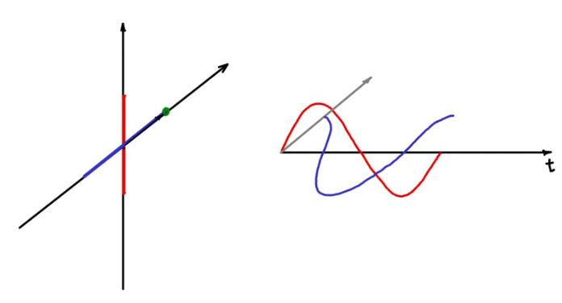
Project analysis slide 2
DQ Axis Theory
Now, a third set of axes is considered where one is parallel to the vertical plane where the sine wave is present and another in the horizontal plane where the cosine wave is present. The variation of the two waves along these axes are then marked.
At t = 0, the sine wave is zero : so the projection will be at the origin of the vertical axis. Since the cosine wave is at the maximum point : so its projection will be at the corresponding maximum point on the horizontal axis. Upon considering both the projections, the point is marked as follows for t = 0 :

Slide 15
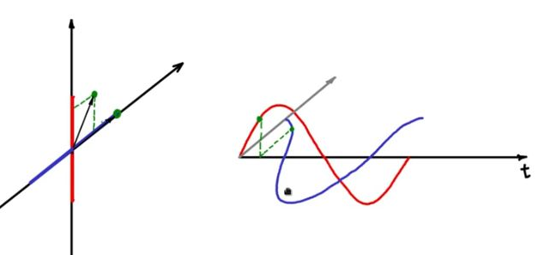
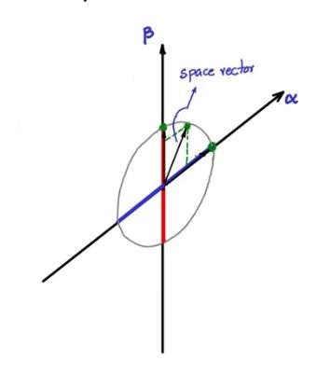
Project analysis slide 2
DQ Axis Theory
Upon moving the reference point a bit further in time and plotting the respective projections on the third set of axes, the location of corresponding point is found to be as :
Time signals represented in Orthogonal planes
Spatial Coordinate System
Upon plotting for each reference point, the locus of all the plotted points is found to be as follows and the two axes are called α-axis and β-axis. The αβ are known as the spatial co-ordinate axes. It is observed that the projected resultant equivalent vector started rotating continuously in the spatial coordinate system, thereby forming locus as circle. So, the two time dependant signals are converted into spatial vectors, continuously rotating in space.

Slide 16
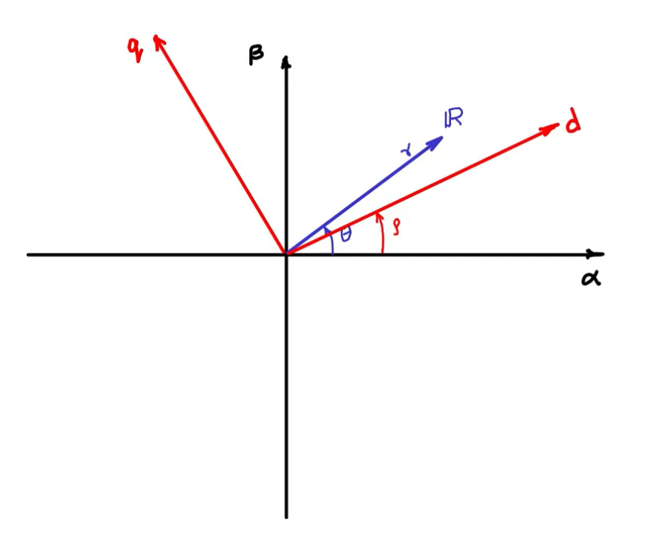
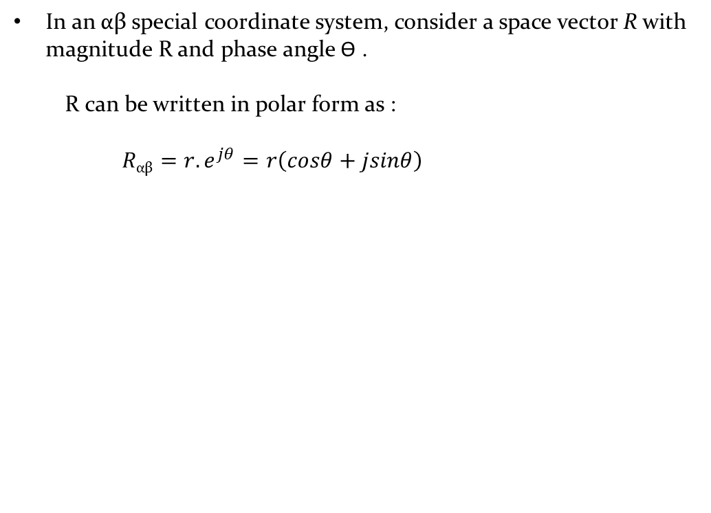
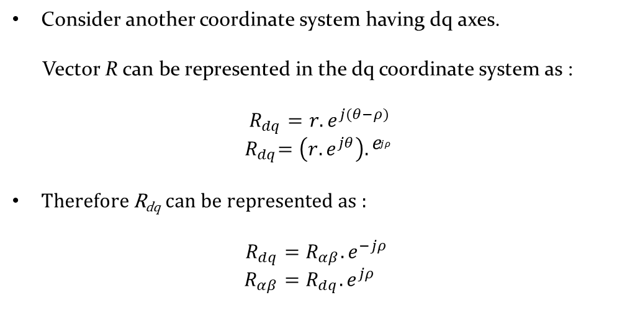
Project analysis slide 2
DQ Axis Theory
In an αβ special coordinate system, consider a space vector R with magnitude R and phase angle Ɵ .
  R can be written in polar form as :
  $R\text{αβ}=r.e^{jθ}=r\left(cosθ+jsinθ\right)$
Consider another coordinate system having dq axes.
Vector R can be represented in the dq coordinate system as :
$R_{dq}=r.e^{j(θ−ρ)}$
${ R}_{dq}=\left(r.e^{jθ}\right). e_{jρ}$
Therefore R_{dq} can be represented as :
$$R_{dq}=R_{αβ}.e^{−jρ}$$
$$R_{αβ}=R_{dq}.e^{jρ}$$

Slide 17
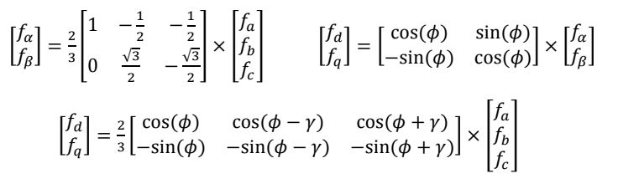
Project analysis slide 2
DQ Transformations
For transformation from the Cartesian coordinate system to the αβ coordinate system to the dq coordinate system, we have :
abc
αβ
dq
For any given vectors f_{a} , f_{b} , f_{c} , if f_{a} + f_{b} + f_{c} = 0 , we have :
where γ = $\frac{2π}{3}$ and ф = angle between the dq and αβ reference frames

Slide 18
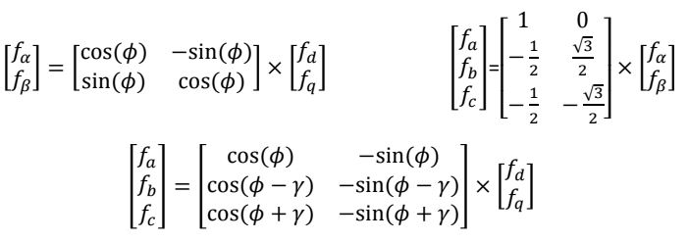
Project analysis slide 2
DQ Transformations
For transformation from the dq coordinate system to the αβ coordinate system to the Cartesian coordinate system, we have :
dq
αβ
abc
For any given vectors f_{a} , f_{b} , f_{c} , if f_{a} + f_{b} + f_{c} = 0 , we have :
where γ = $\frac{2π}{3}$ and ф = angle between the dq and αβ reference frames

Slide 19
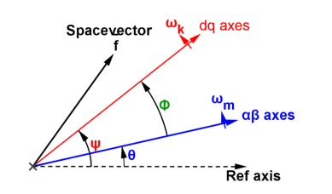
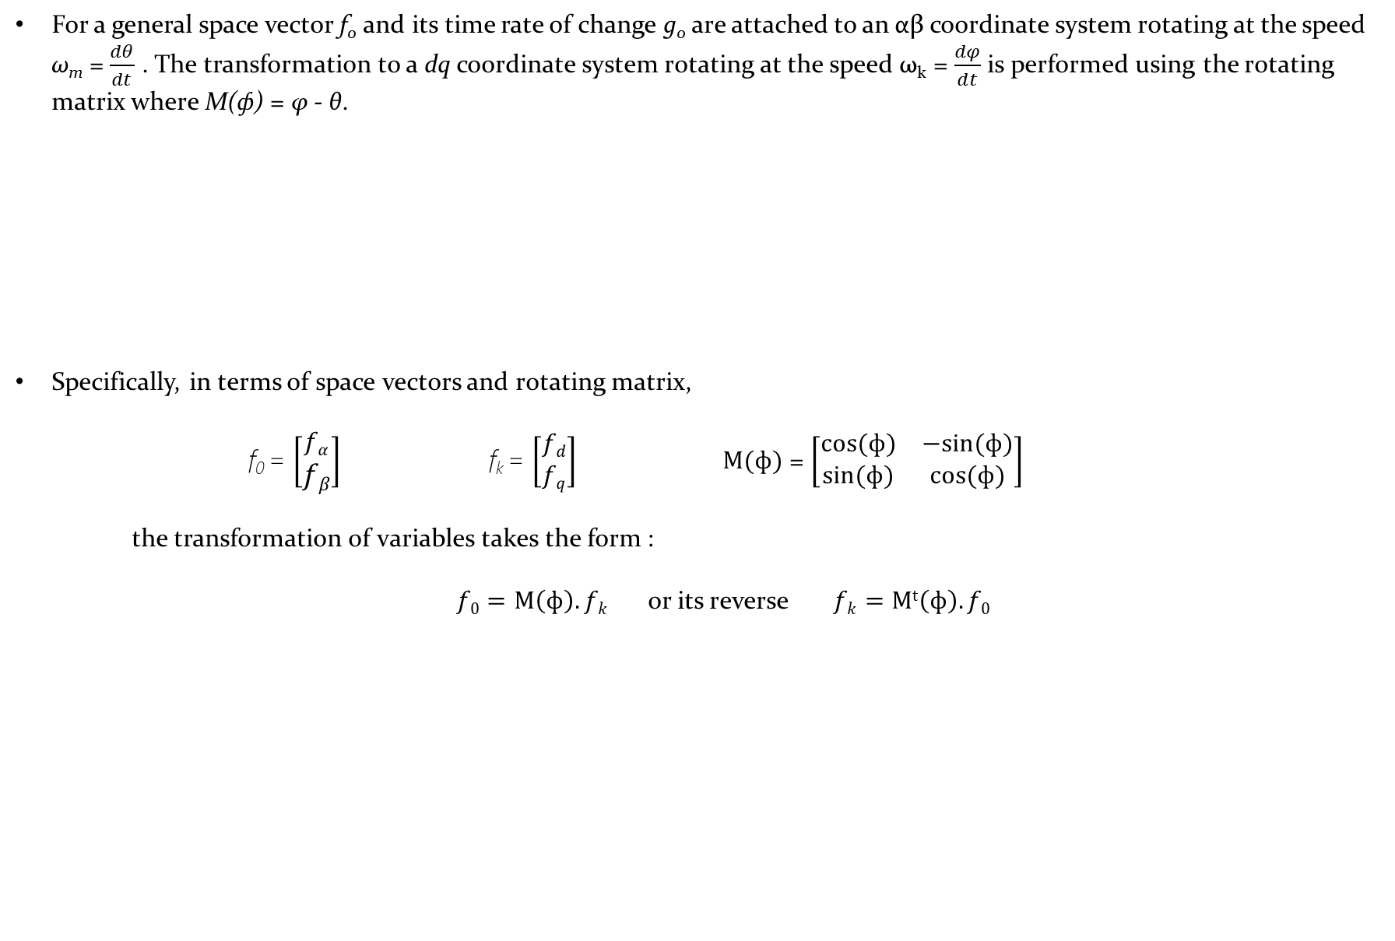
Project analysis slide 2
DQ Transformations
For a general space vector f₀ and its time rate of change g₀ are attached to an αβ coordinate system rotating at the speed ω_{m} = $\frac{dθ}{dt}$ . The transformation to a dq coordinate system rotating at the speed ω_{k} = $\frac{dφ}{dt}$ is performed using the rotating matrix where M(ф) = φ - θ.
Specifically, in terms of space vectors and rotating matrix,
    f₀ = $\left[\begin{aligned}fα \\ fβ\end{aligned}\right]$ f_{k} = $\left[\begin{aligned}fd \\ fq\end{aligned}\right]$ $M(ф)$ = $\left[\begin{matrix}cos⁡(ф) & −sin(ф) \\ sin(ф) & cos⁡(ф)\end{matrix}\right]$
    the transformation of variables takes the form :
    $f0=M\left(ф\right).fk$or its reverse $fk=Mt\left(ф\right).f0$

Slide 20
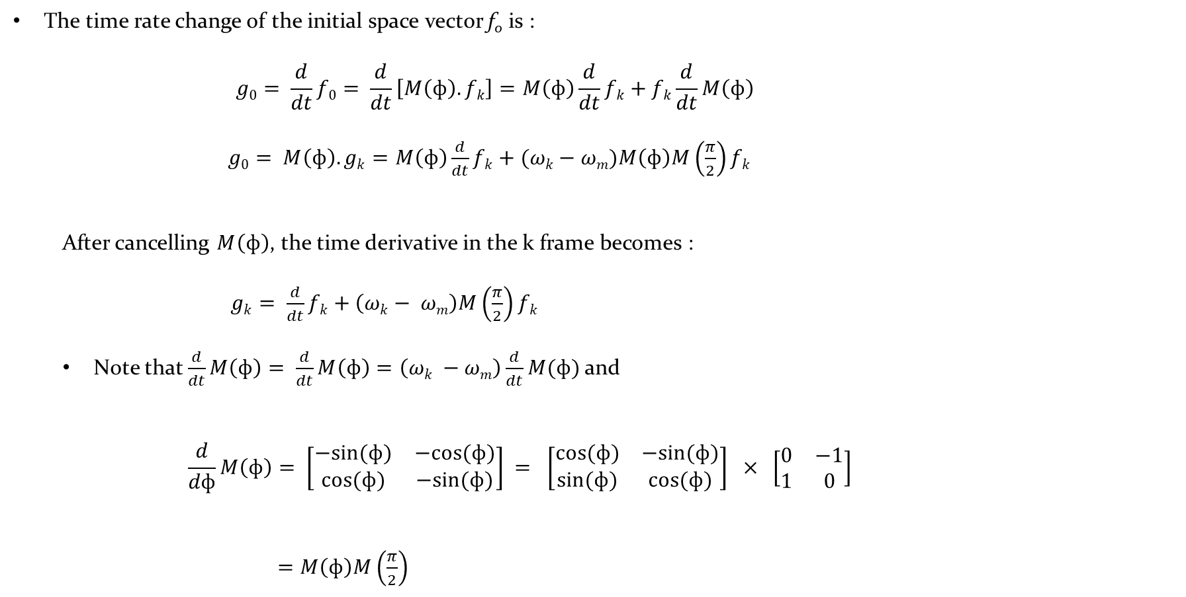
Project analysis slide 2
DQ Transformations
The time rate change of the initial space vector f₀ is :
        $$g0= \frac{d}{dt}f0= \frac{d}{dt}\left[M\left(ф\right).fk\right]=M\left(ф\right)\frac{d}{dt}fk+fk\frac{d}{dt}M\left(ф\right)$$
        $g0= M\left(ф\right).gk=M\left(ф\right)\frac{d}{dt}fk+(ωk−ωm)M\left(ф\right)M\left(\frac{π}{2}\right)fk$
  After cancelling $M\left(ф\right)$, the time derivative in the k frame becomes :
  $gk= \frac{d}{dt}fk+\left(ωk− ωm\right)M\left(\frac{π}{2}\right)fk$
  Note that $\frac{d}{dt}M\left(ф\right)= \frac{d}{dt}M\left(ф\right)=\left(ωk −ωm\right)\frac{d}{dt}M(ф)$ and
      $$\frac{d}{dф}M\left(ф\right)= \left[\begin{matrix}−sin(ф) & −cos⁡(ф) \\ cos⁡(ф) & −sin(ф)\end{matrix}\right] = \left[\begin{matrix}cos⁡(ф) & −sin(ф) \\ sin(ф) & cos⁡(ф)\end{matrix}\right] × \left[\begin{matrix}0 & −1 \\ 1 & 0\end{matrix}\right]$$
        $=M\left(ф\right)M\left(\frac{π}{2}\right)$

Slide 21
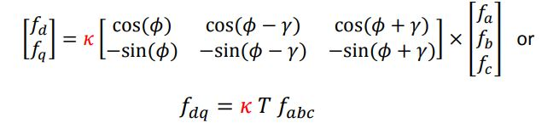

Project analysis slide 2
DQ Transformations
Pseudo-inverse conversion :
Quadratic form conversion :
Magnitude conversion :

Slide 22

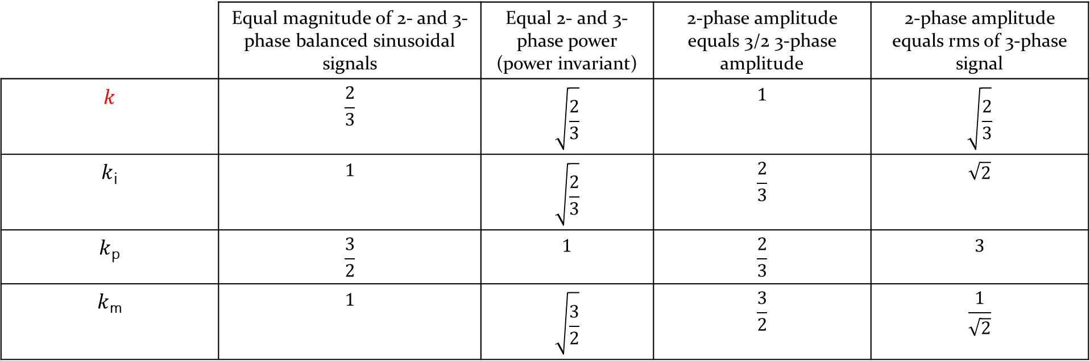
Project analysis slide 2
DQ Transformations
The value of $k$ varies with different types of input signals. Some of the common conventions are listed below :
 | Equal magnitude of 2- and 3-phase balanced sinusoidal signals | Equal 2- and 3-phase power (power invariant) | 2-phase amplitude equals 3/2 3-phase amplitude | 2-phase amplitude equals rms of 3-phase signal
$$k$$ | $$\frac{2}{3}$$ | $$\sqrt{\frac{2}{3}}$$ | $$1$$ | $$\sqrt{\frac{2}{3}}$$
$k$_{i} | $$1$$ | $$\sqrt{\frac{2}{3}}$$ | $$\frac{2}{3}$$ | $$\sqrt{2}$$
$k$_{p} | $$\frac{3}{2}$$ | $$1$$ | $$\frac{2}{3}$$ | $$3$$
$k$_{m} | $$1$$ | $$\sqrt{\frac{3}{2}}$$ | $$\frac{3}{2}$$ | $$\frac{1}{\sqrt{2}}$$

Slide 23
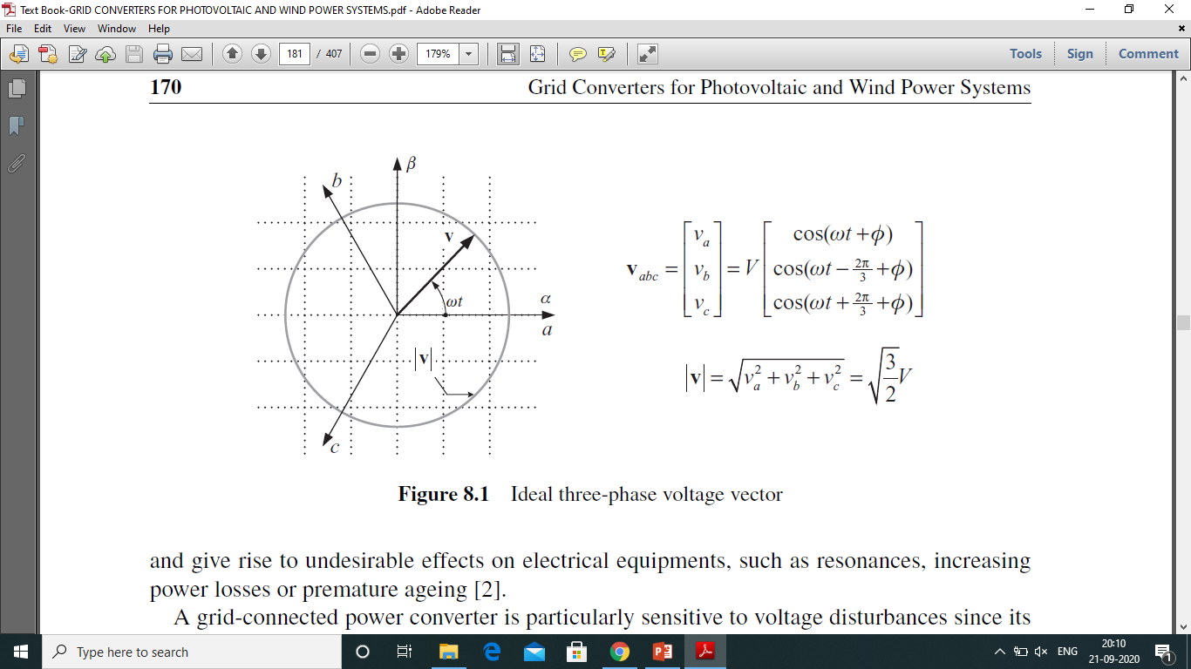
Project analysis slide 2
Grid Synchronization
One of the most important aspects to consider in the control of power converters connected to electrical grids is the proper synchronization with the three-phase utility voltages. This three-phase synchronization is not just a matter of multiplying by three the synchronization system used in single-phase applications, since the three phases of a three-phase system do not work autonomously but do it in a coordinated way, keeping particular relationships in terms of phase shifting and phase sequencing. Therefore, the three-phase voltage should be understood as a vector consisting of three voltage components, which provides the capability of generating and consuming power in a three-phase system.
Synchronization means the minimization of difference in voltage, frequency and phase angle between the corresponding phases of the generator output and grid supply. An alternating current generator must be synchronized with the grid prior to connection.
The module and the rotation speed of the three-phase grid voltage vector keep constant when balanced sinusoidal waveforms are present in the three phases of the system – with equal amplitude, frequency and relative phase shifting. Under such ideal operating conditions, the voltage vector describes a circular locus on a Cartesian plane, generally known as the αβ plane.

Slide 24
Project analysis slide 2
Grid Synchronization
A grid-connected power converter is particularly sensitive to voltage disturbances since its control system might lose controllability on the power signals under such distorted operating conditions, which could trip any of its protection systems or might even destroy the power converter.
Moreover, a power converter can interact with the grid at the point of common coupling in order to attenuate the voltage disturbances and reduce their undesirable effects. For these reasons, the voltage vector disturbances should be properly detected by the synchronization system, and the control system of the power converter should react to both ride-through such operating conditions and provide some support to the grid.
Therefore, grid synchronization of three-phase power converters entails the usage of advanced detection systems, specially designed to both reject high-order harmonics and identify the sequence components of the voltage vector in a fast and precise way. Particularly, the real-time detection of the sequence components of the voltage vector in three-phase networks is an essential issue in the control of distributed generation and storage systems.
The most extended technique used for frequency-insensitive grid synchronization in 3-ф systems is the PLL based on the synchronous reference frame (SRF-PLL).

Slide 25
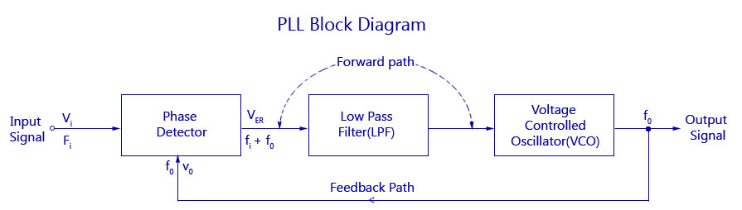
Project analysis slide 2
Phase Locked Loops
A Phase Locked Loop (PLL) is an electronic circuit with a voltage or current driven oscillator that is constantly adjusted to match in phase with the (and thus lock on) the frequency of an input signal. The PLL is used in various applications of electrical technology as a fundamental concept.
The basic idea of phase locking is to evaluate the difference between phase angle of the input signal and generated output signal. The phase difference is usually estimated by a phase detector (which is usually a multiplier or comparator), Voltage-Controlled Oscillator (VCO) and loop controller or a Loop Pass Filter (LPF).
The phase angle difference between of the input signal and output signal is measured by the Phase Detector and also provides a proper error signal. To generate the output signal, the LPF output signal drives the Voltage-Controlled Oscillator (VCO). The VCO provides a measure of variations of the phase and generates a signal whose frequency is equal to its input signal.
The deviation of the error signal from zero is because of any change in the phase angle (or frequency) of the input signal.
Block diagram of a conventional PLL

Slide 26
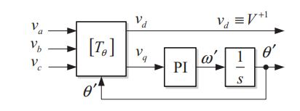
Project analysis slide 2
SRF-PLL
Basic block diagram of SRF-PLL
The conventional SRF-PLL translates the three-phase voltage vector from the abc natural reference frame to the dq rotating reference frame by using Park’s transformation [T_{θ} ]. The angular position of this dq reference frame is controlled by a feedback loop that regulates the q component to zero. The [T_{θ} ] transformation in this PLL has been rescaled by using a 2/3 factor in order to detect the amplitude of the sinusoidal input signal instead of the module of the input voltage vector. Therefore, in the steady state, the d component depicts the amplitude of the sinusoidal positive-sequence input voltage
(V⁺¹) and its phase angle is determined by the output of the feedback loop ( θ’ ).
The significance of this structure is in the fact that it avoids the double-frequency error problem of single-phase standard PLL thanks to the symmetry of three-phase signals. Moreover, it has a relatively simple structure that offers ease of parameter tuning and robust features for digital implementation.
Under ideal grid conditions, i.e. when the grid voltage is not affected by either harmonic distortion or unbalances, setting a high bandwidth for the SRF-PLL feedback loop yields a fast and precise detection of the phase angle and amplitude of the grid voltage.

Slide 27
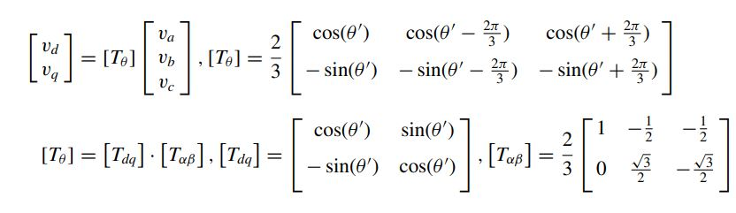
Project analysis slide 2
SRF-PLL
abc-dq transformation for SRF-PLL
To synchronize Voltage Source Inverter with the grid, it is necessary to match the parameters of electrical grid system with the inverter system. Implementation of the SRF-PLL algorithm will be done with an embedded system (DSP Controller) and simulated and tested for the results in MATLAB..
Code Composer Studio will be used for entering parameters in DSP System

Slide 28
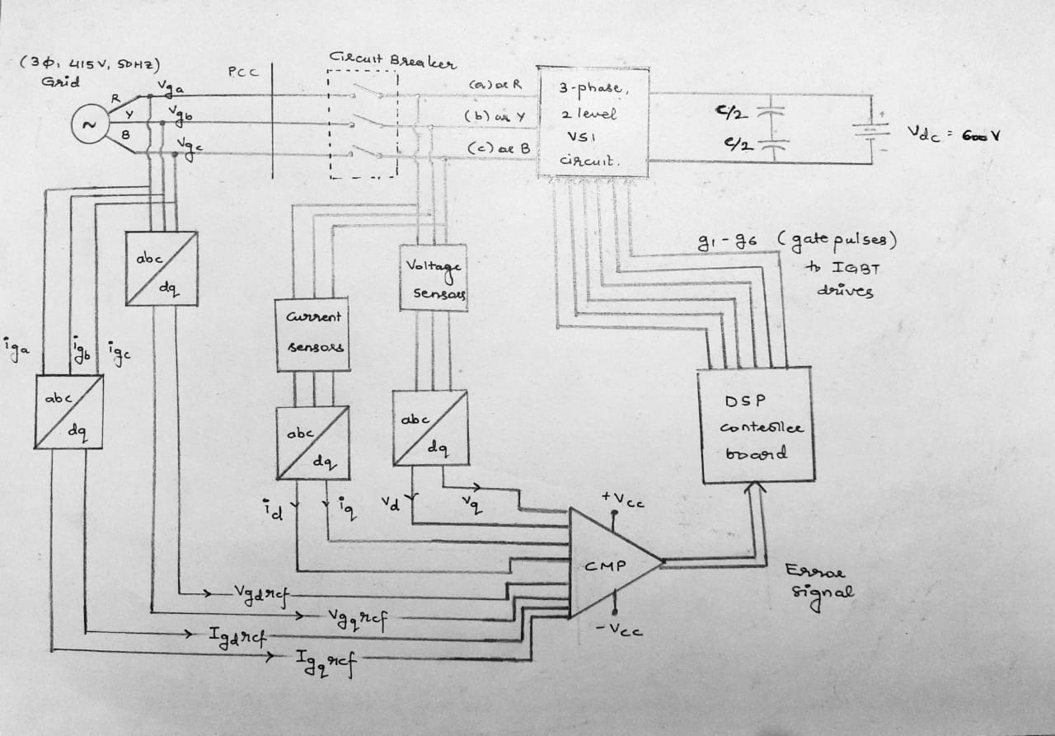
Project analysis slide 2
Block Diagram
Overall Block Diagram for 3-ф , 2 level VSI Grid Synchronization using SRF technique

Slide 29
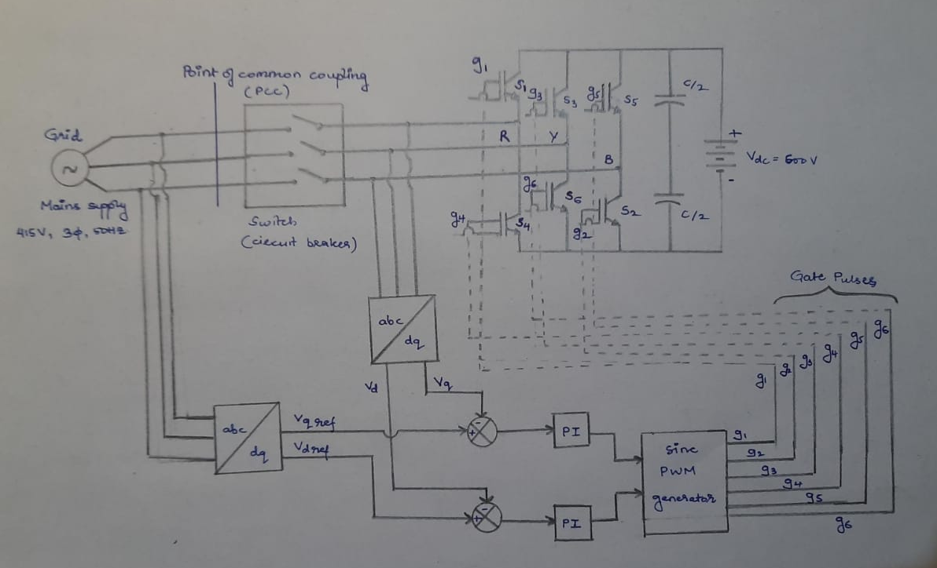
Project analysis slide 2
Circuit Model
Circuit Model for 3-ф , 2 level VSI Grid Synchronization using SRF technique

Slide 30
Project analysis slide 2
Hardware Details
Invertor : Semikron Make (3-phase, 2-level VSI) [ Product Type : SKAI 45 A2 GD12-WCI ]
V_{dc} = 600V, V_{ac} = 415, 3ph, 50Hz.
Topology: 4-leg (each leg two IGBT switches)
Liquid Cooling
DSP LaunchPad (controller board): LAUNCHXL-F28379D (+ 5V = V_{cc})
Voltage and current sensors are used for feedback at invertor’s AC output side.
Apart from these, there are general requirements such as DMMs, CRO, connecting wires, Dimmerstats etc. which are available in the Non-conventional energy lab.
Voltage sensors (for 3-φ at PCC and dc-link voltage) | 04 | LEM-Voltage transducer LV 25 P
Current Sensors (3-φ currents & neutral current at PCC) | 04 | LEM-Current transducer LA 55 P

Slide 31
Project analysis slide 2
References
“Overview of Control and Grid Synchronization for Distributed Power Generation Systems” : Frede Blaabjerg ,Remus Teodorescu, Marco Liserre and Adrian V. Timbus.
‘Voltage-Sourced Convertors in Power System’ : Amirnaser Yazdani, Reza Iravani
NPTEL Lectures on ‘Design of Photovoltaic Systems’ by Prof. L. Umanand
Grid Convertors for PV and Wind power systems : Remus Teodorescu, Marco Liserre , Pedro Rodriguez
"Synchronization methods for grid-connected voltage source converters,“ : J. Svensson
"Analysis and Comparison of Phase Locked Loop Techniques for Grid Utility Applications“ : L.R. Limongi, R. Bojoi, C. Pica, F. Profumo, A. Tenconi
"Phase-locked loop techniques-A survey,“ : G. C. Hsieh and J. C. Hung
LAUNCHXL-F28379D User’s guide : SPRUI77C - August 2016 – Revised March 2019
SKAI 45 A2 GD12-WCI Datasheet : Semikron Invertor Systems

Slide 32
Project analysis slide 2
Thankyou !

